Slide 1

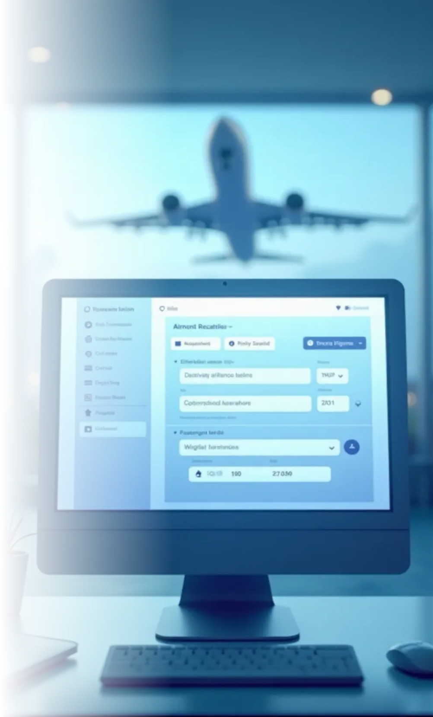
Airline Reservation System
A digital platform for booking flights, managing passenger data, and optimizing airline operations. Includes ER diagrams to visualize database relationships.
Prepared By : Sarwar , Shafiullah , Hassib

Slide 2


System Overview
The system streamlines flight bookings, seat allocations, and passenger management for airlines and customers. Passengers, airline staff, and administrators interact with the system for different functionalities. Core features include flight search, ticket booking, payment processing, and cancellation handling.
Purpose
Key Users
Core Features
Streamlines flight bookings, seat allocations, and passenger management for airlines and customers.
Passengers, airline staff, and administrators interact with the system for different functionalities.
Flight search, ticket booking, payment processing, and cancellation handling.

Slide 3


Key Components
1
Flight Management
2
Passenger Module
Tracks flight schedules, routes, and availability in real-time.
Stores personal details, booking history, and preferences.
3
Payment Gateway
4
Admin Dashboard
Secure transactions for tickets, refunds, and ancillary services.
Allows staff to update flights, manage fares, and generate reports.

Slide 4




ER Diagram Overview
The ER Diagram Overview provides a clear depiction of the database structure, highlighting entities, their relationships, and attributes with a visual aid for better understanding.
Entities
Relationships
Key tables include Airport, Airplane, Flights, Passengers, Bookings, Payments, and Users.
Demonstrates how passenger bookings link to flights and payment records.
1
2
Visual Aid
4
3
Attributes
Diagram included for clarity (insert ER image placeholder).
Each entity field (e.g., Flight ID, Seat Number) is labeled clearly.

Slide 5


Booking Process
1
2
3
4
Search Flights
Select Seats
Confirm Payment
E-Ticket
Users input dates/destinations to view available options
Interactive seat map for choosing preferred locations
Integration with credit/debit card or digital wallets
Auto-generated with booking details sent via email/SMS

Slide 6




Benefits
Efficiency
Cost-Effective
Reduces manual errors and speeds up reservations
1
2
Lowers operational costs with automated workflows
Scalability
User-Friendly
4
3
Adapts to growing airline networks and passenger volumes
Intuitive interface for seamless customer experience

Slide 7



Challenges
Security Risks
System Downtime
Integration Complexity
Requires robust encryption for sensitive data protection
High availability is critical during peak booking times
Must synchronize with third-party APIs (e.g., payment gateways)

Slide 8
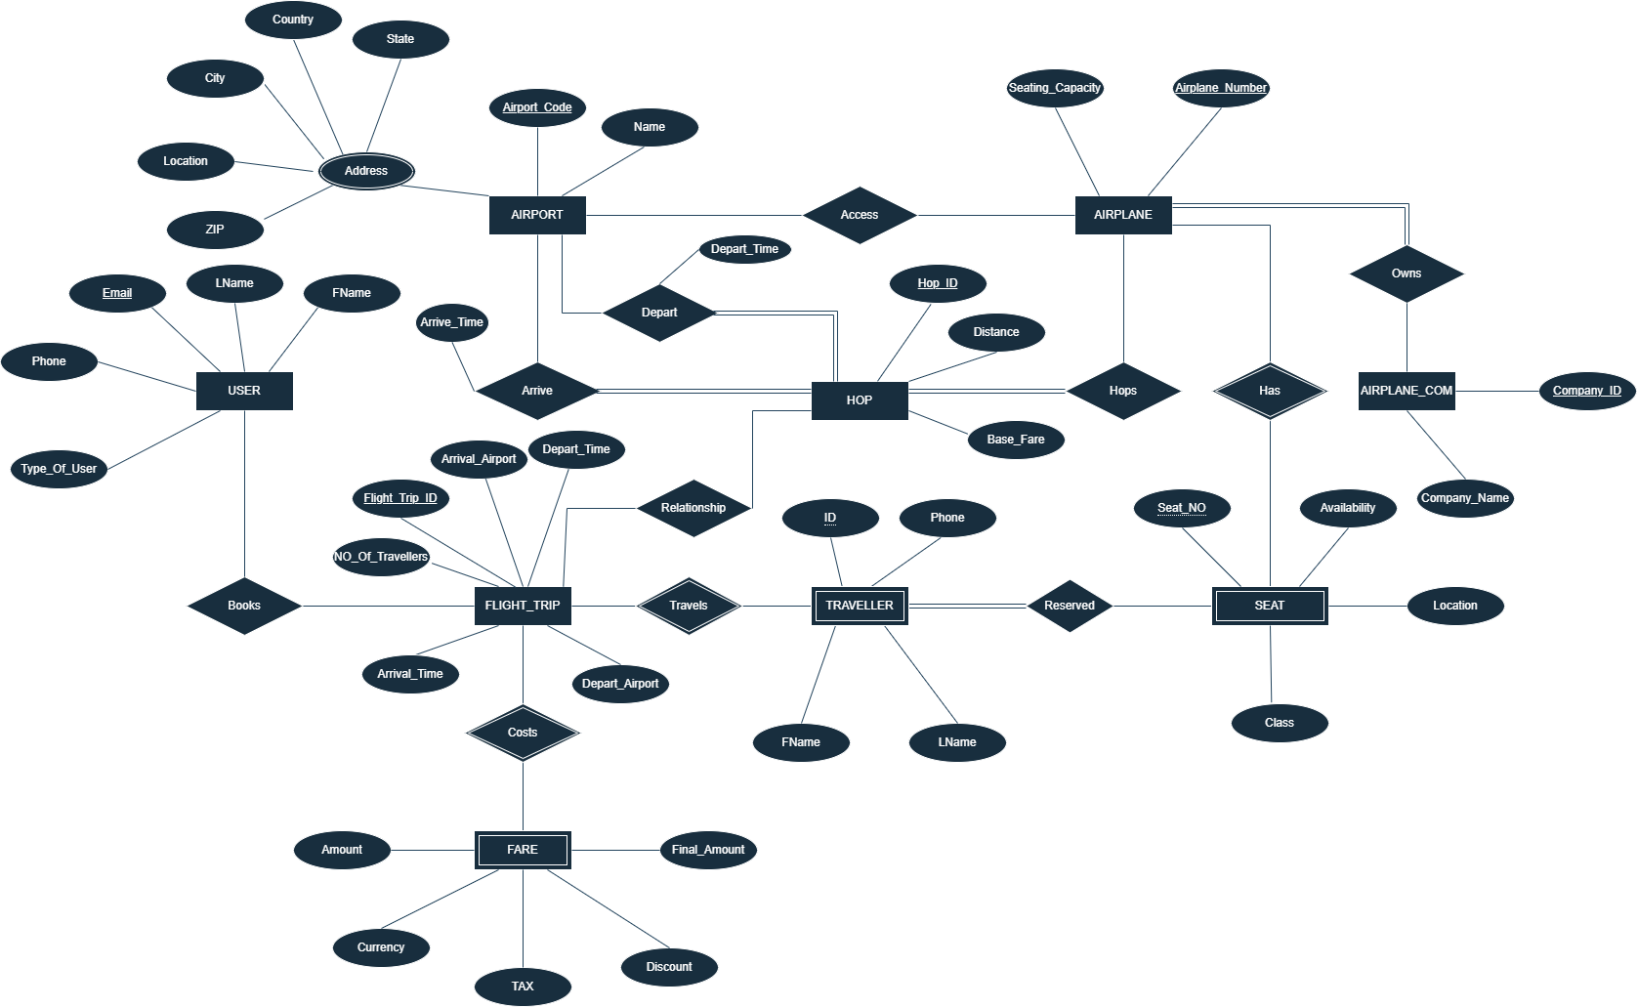

Slide 9



Conclusion
ER Diagram
2
The ER diagram helps to have a better visualization of the system and the relationship between components
Airline Reservation System
1
Helps to organize and keep tracks of flights, payments, passengers , and to have a better management
Implementation
3
The system can be implemented to have a better service and overall management

